Slide 1
DIP 2013 – Smart Fast Forward

Slide 2
Overview

Slide 3
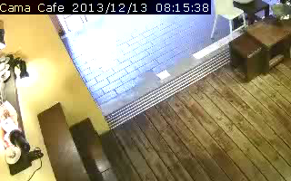
Smart Fast Forward Concept

Slide 4
Processing Stage Overview
Multi-Threaded!
OpenCV
Decoder
Background
Subtraction
Object Detection
Video
Object Regions & Labels
Object Labeling
(Tracking)
Frame weight
estimation
Kalman
Filter
Playback Speed

Slide 5
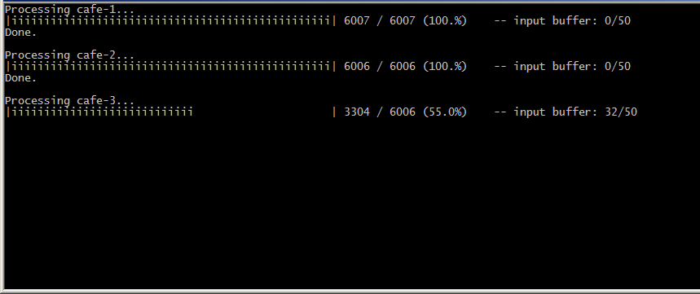
Processing Stage Output

Slide 6
Background Subtraction

Slide 7
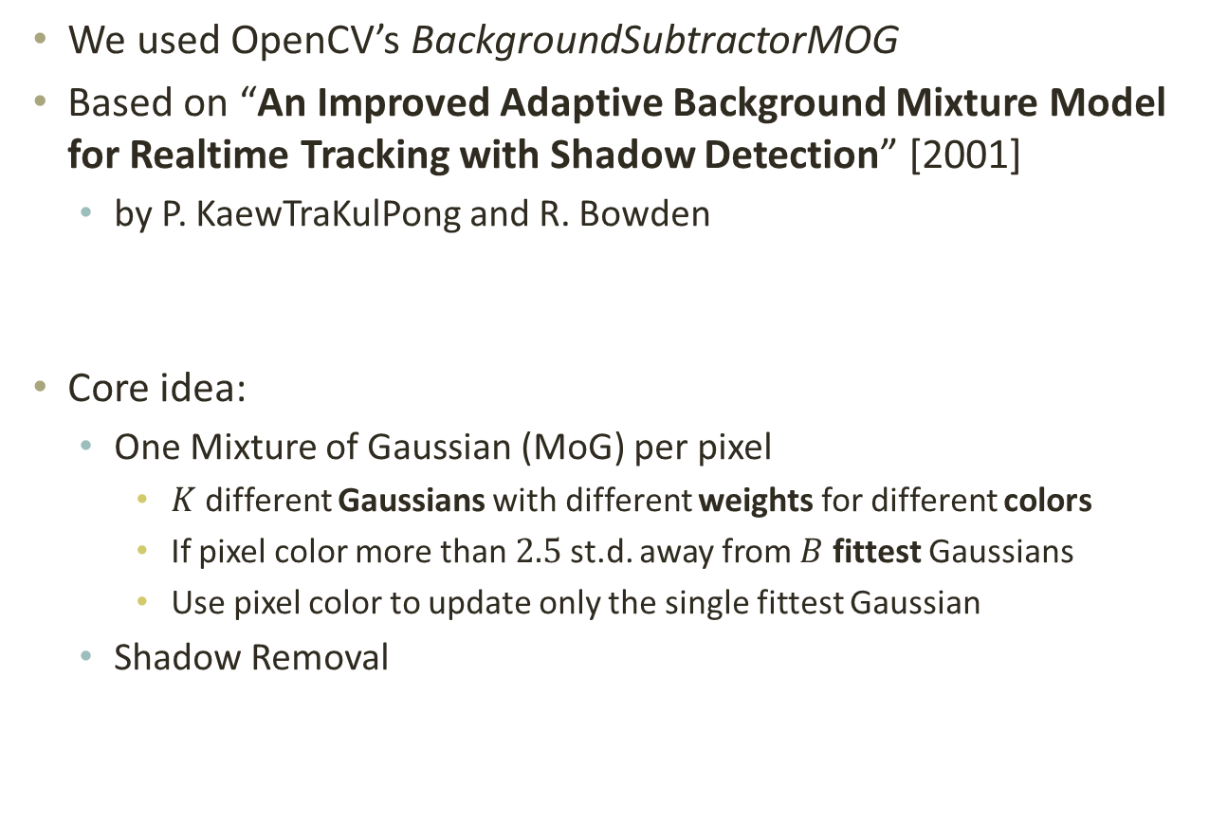
Background Subtraction MoG
We used OpenCV’s BackgroundSubtractorMOG
Based on “An Improved Adaptive Background Mixture Model for Realtime Tracking with Shadow Detection” [2001]
by P. KaewTraKulPong and R. Bowden
Core idea:
One Mixture of Gaussian (MoG) per pixel
$K$ different Gaussians with different weights for different colors
If pixel color more than $2.5$ st.d. away from $B$ fittest Gaussians
Use pixel color to update only the single fittest Gaussian
Shadow Removal

Slide 8
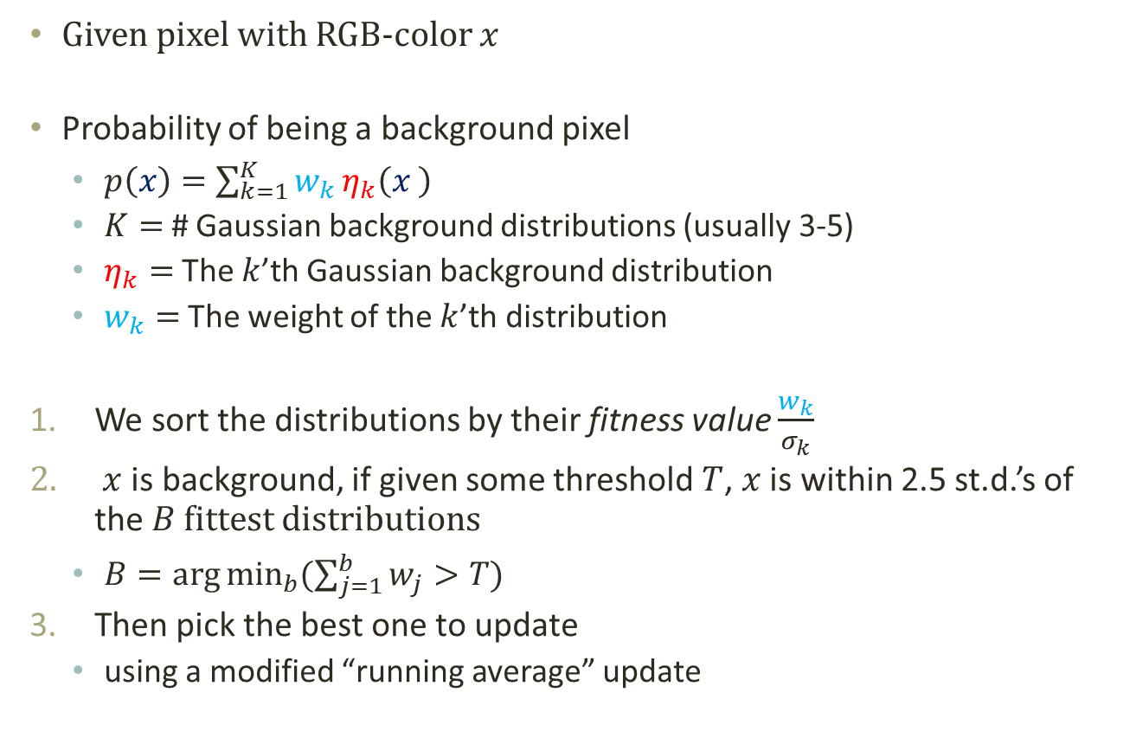
Background Subtraction MoG
Given pixel with RGB-color $x$
Probability of being a background pixel
$p\left(x\right)=\sum_{k=1}^{K}{w_{k}}η_{k}\left(x \right)$
$K=$ # Gaussian background distributions (usually 3-5)
$η_{k}=$ The $k$’th Gaussian background distribution
$w_{k}=$ The weight of the $k$’th distribution
We sort the distributions by their fitness value $\frac{w_{k}}{σ_{k}}$
$x$ is background, if given some threshold $T$, $x$ is within 2.5 st.d.’s of the $B$ fittest distributions
$B=\arg{\min_{b}{(\sum_{j=1}^{b}{w_{j}}>T)}}$
Then pick the best one to update
using a modified “running average” update

Slide 9
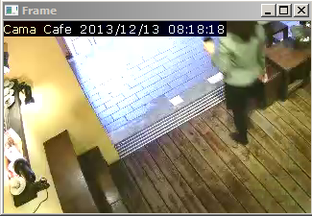
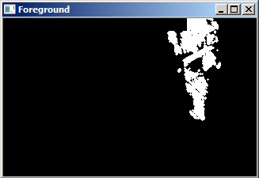
Background Subtraction Results

Slide 10
Object detection

Slide 11
Object Detection
Object detection includes the main phase to identify objects in a scene by means of clustering.
Simple techniques are used to perform preliminary denoising, and small cluster that is likely to be noise / false response (such as shadows) are also discarded.
Denoise
Clustering
Abandon small cluster

Slide 12
Object Detection Agglomerative Clustering
Clustering to identify individual.
But centroid-based clustering are prone to stretched clusters or varying cluster size.
Agglomerative (Hierarchical) Clustering: bottom-up, close clusters merged first.
One of the efficient implementations is similar to finding a planar Minimum-Spanning Tree.
Finals clusters are broken by “weakest” (farthest) link
Closest clusters are then merged into a larger one
Initially each pixel is an individual cluster

Slide 13
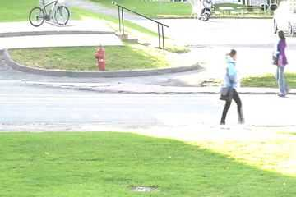
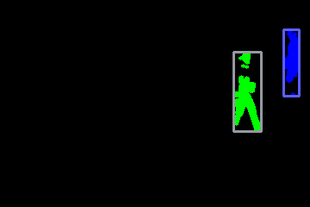
Object Detection Intermidiate Result

Slide 14
Object Tracking

Slide 15
Object Tracking Matching
Inter-frame relationship (which object becomes which in the next frame) are determined by a weighted matching.
Here, the term “matching” is general and it is possible for multiple object to match into one (occlusion) or one object to split into multiple.
Matching cost between two clusters (of consecutive frame) is a value determined by their:
difference in feature (expected position, size)
penalty depending on situations (e.g. merging, abandoning)
Could be solved as a minimum-cost matching problem, where efficient algorithms (e.g. Hungarian Method) exist.

Slide 16
Object Tracking Matching Model
Frame @ t-1
Frame @ t
Links have cost associated with feature difference between clusters
Using a node multiple time (overlapping) has additional cost
A node that is not matched (discarded/new cluster) has cost proportional to cluster size
NIL
NIL

Slide 17
Playback Speed estimation

Slide 18
Playback Speed Estimation Frame Weights
Used to determine the “importance” of a frame, and thus affects the playback speed.
Frame weights are determined by the following factors:
Number of objects in frame
Matching cost -> scene variation
Foreground area size
Basic smoothing (running average)

Slide 19
Playback Speed Estimation Playback Sequence
The higher the frame weight, the slower the playback speed.
Relation between frame weight and frame duration is linear. Specifically, given parameters MaxSpeedUp, TotalFrame, each frame weight is reweighted to: w_{new} = 1 + (w_{old}–w_{min})/(w_{max}–w_{min}) * (MaxSpeedUp-1) * TotalFrame
Time spent on a frame is proportional to the adjusted weight, so the playback sequence could easily be determined accordingly.

Slide 20
Results
TODO

